Slide 1
COM4012M – PHP & SQL
Week 7 Lab Session 7

Slide 2
PHP Recap
PHP is a server scripting language that executes scripts on the server and returns them to a browser as plain HTML. Essentially, PHP output HTML pages.
PHP files can contain text, HTML, CSS, JavaScript and PHP code. They end in the .php file extension.
PHP script can be nested in-between two tags like so:
<?php
//php code goes here
?>

Slide 3
Example PHP
<!DOCTYPE html>
<html>
<body>
<h1>My first PHP page</h1>
<?php
echo "Hello World!";
?>
</body>
</html>

Slide 4
PHP Recap
PHP supports a range of data types that can be used in the usual code operations like if statements and for/whiles loops.
String - Text (can be “ or ‘)
Integer - Whole number
Float (floating point number) - Numbers with decimal
Boolean - True/False
Array - Lists
Class/Object - Objects are Class properties
NULL - Only one value of NULL
Resource - Not technically a data type but references external resources and functions.

Slide 5
SQL
This week we will be using PHP to connect to a database in which in order for us to access and manipulate said database, we will use SQL.
SQL stands for Structured Query Language and is the standard language for accessing and manipulate databases.
SQL can be used to execute queries, retrieve data, insert records, update records, delete records, create new databases, create new tables, create stored procedures, create views, set permissions and more.

Slide 6
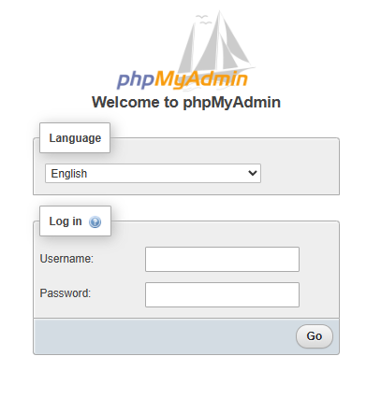
phpMyAdmin
The database system we will be using for this module is phpMyAdmin.
phpMyAdmin can be accessed at:
www.ysjcs.net/phpmyadmin
You will have been provided with account details in a recent email from the technicians (if you have any problems with your account -> contact them).

Slide 7
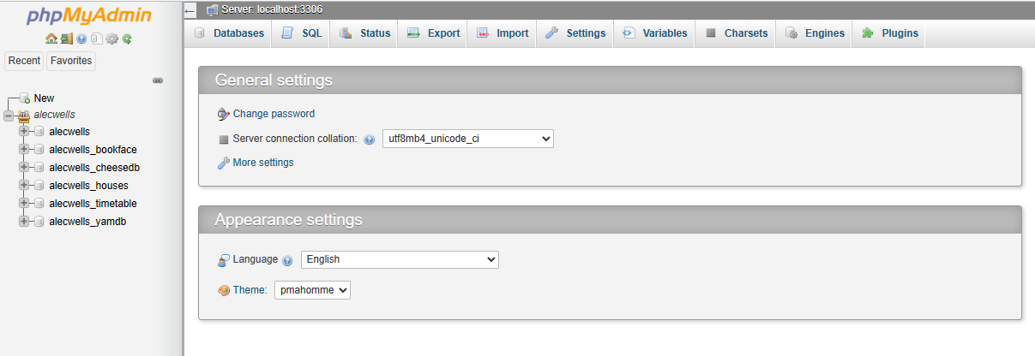
phpMyAdmin
Once logged in, your phpMyAdmin will look something like this (though yours will be a bit emptier to start):
On the left, is a list of databases, which you can view by clicking on them. We can interact with phpMyAdmin using SQL commands after setting up a connection, but we can also interact with it on the web if need be.

Slide 8
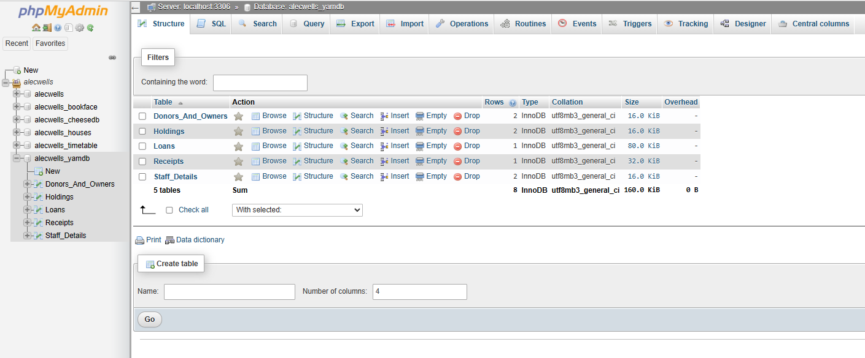
phpMyAdmin
Once you have created a database you can click it and be presented with the list of tables for that database:

Slide 9
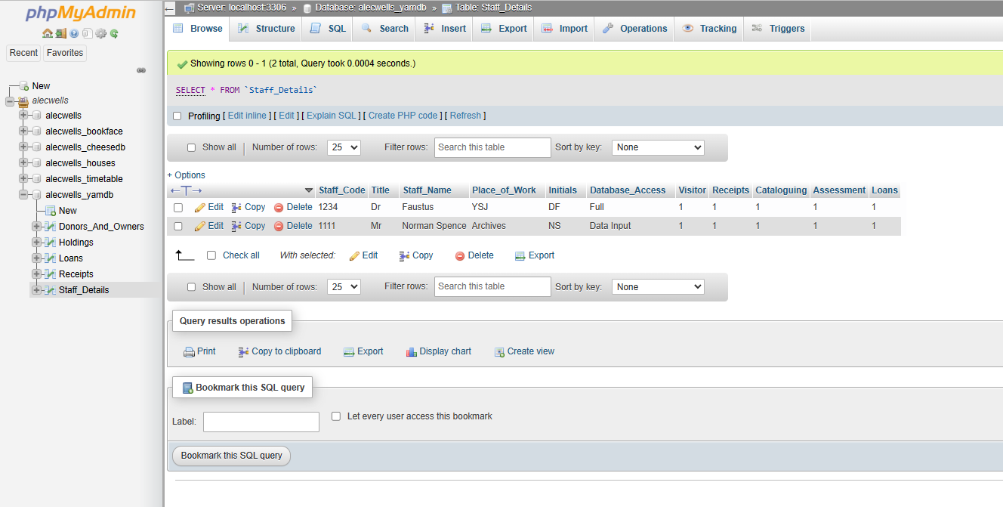
phpMyAdmin
Once you have created a table, we can then click it to see all the information stored in it:

Slide 10
PHP Connect to MySQL
<html>
<head>
<title>MySQL Connection Test</title>
</head>
<body>
<?php
// Database connection details
$servername = 'localhost';
$username = 'user.name';
$password = '123456';
$database = 'username';
// Establish connection
$conn = mysqli_connect($servername, $username, $password, $database);
// Check connection and database selection
if ($conn) {
echo "<p style='color:green;'>MySQL you are connected to the database <b>$database</b></p>";
} else {
echo "<p style='color:red;'>MySQL you are not connected, error: " . mysqli_connect_error() . "</p>";
}
// Close connection
mysqli_close($conn);
?>
</body>
</html>
( -> is used to call a method in PHP, or access a property, on the object of a class )

Slide 11
PHP Connect to MySQL
<?php
$servername = "localhost";
$username = "username";
$password = "password";
$databasename =“databasename”;
// Create connection
$conn = new mysqli($servername, $username, $password, $databasename);
// Check connection
if ($conn->connect_error) {
die("Connection failed: " . $conn->connect_error);
}
echo "Connected successfully";
?>
( -> is used to call a method in PHP, or access a property, on the object of a class )

Slide 12
PHP Connect to MySQL
$servername = "localhost";
$username = “alec.wells";
$password = "pass123";
$databasename =“alecwells_yamdb”;
A connection will automatically be closed when the script ends, though to close a connection before you can use:
$conn->close();

Slide 13
SQL
Once connected, we can write SQL statements to perform actions on a database. SQL statements are built using keywords such as:
SELECT - extracts data from a database
UPDATE - updates data in a database
DELETE - deletes data from a database
INSERT INTO - inserts new data into a database
CREATE DATABASE - creates a new database
ALTER DATABASE - modifies a database
CREATE TABLE - creates a new table
ALTER TABLE - modifies a table
DROP TABLE - deletes a table
CREATE INDEX - creates an index (search key)
DROP INDEX - deletes an index

Slide 14
SQL Examples
CREATE TABLE Persons (
PersonID int(6),
Name varchar(50),
);
INSERT INTO Persons (PersonID, Name)
VALUES (‘20’, ‘John Blackthorne’);
DELETE FROM Persons WHERE Name=‘John Smith’;
UPDATE Customers
SET Name = ‘Anna Smith’
WHERE PersonID = 12;

Slide 15
Creating a Database
To create a database with SQL we can use the statement:
CREATE DATABASE myDB
To do this in a PHP script, we can add write this after our PHP connection like so:
// Create database
$sql = "CREATE DATABASE myDB";
if ($conn->query($sql) === TRUE) {
echo "Database created successfully";
} else {
echo "Error creating database: " . $conn->error;
}
$conn->close();
?>

Slide 16
Creating a Table
// sql to create table
$sql = "CREATE TABLE Students(
id INT(6) UNSIGNED AUTO_INCREMENT PRIMARY KEY,
studentname VARCHAR(30) NOT NULL,
course VARCHAR(30) NOT NULL,
subject VARCHAR(30) NOT NULL,
)";
if ($conn->query($sql) === TRUE) {
echo "Table Students created successfully";
} else {
echo "Error creating table: " . $conn->error;
}
$conn->close();
?>

Slide 17
Forms with PHP & SQL
For websites, our database functionality will often be tied to forms, such as login screens, registering, searching for products etc.
Here is an example of a search query where we input a name into a form and retrieve the rest of the information from our database. First, we start on a HTML page with a form:
<body>
<form id="myform" method="post“ action="read_record.php">
Name: <input type="text" id="studentname“ name="studentname" />
<input type="submit">
</form>
</body>
The action will post to a PHP page we have setup, in this case read_record.php

Slide 18
Forms with PHP & SQL
<?php
$studentname = $_REQUEST['studentname’]; -> Here is the ID from our form
$conn=mysqli_connect('localhost','yourloginname','yourpassword','yourdatabasename’);
$sql="SELECT * FROM Students where studentname='$studentname' ";
<if for if connection succeeds or not>
if ($row=mysqli_fetch_array($rs)) {
$course=$row['course’];
$subject=$row['subject’];
echo ("<table>");
echo ("<tr><td>Name:</td><td>".$studentname. "</td></tr>");
echo ("<tr><td>Course:</td><td>".$course."</td></tr>");
echo ("<tr><td>Subject:</td><td>".$subject."</td></tr>");
echo ("</table>");
}
else {
echo ("<p>Name not found</p>");
}
mysqli_close($conn); //close connection to database
?>

Slide 19
Forms with PHP & SQL
Alternatively, instead of retrieving data from our database, here is an example if we wanted to insert data from our website to a database. Again, we start with a HTML form:
<form method="post" action="add_record.php">
<p>Name: <input type="text" name="studentname" /></p>
<p>Course B.Sc.: <input type="checkbox" name="course" /></p>
<p>Subject: <select name="subject">
<option value="Comp Sci">Computer Science
<option value="Design">Design
<option value="Arts">Arts
<option value="Business">Business
</select>
</p>
<input type="submit">
</form>

Slide 20
Forms with PHP & SQL
<?php
$studentname = $_REQUEST["studentname"];
if (isset($_REQUEST['course'])) {
$course="B.Sc.";
}
else {
$course="Not Degree";
}
$subject = $_REQUEST['subject'];
$conn=mysqli_connect('localhost','xxxxx',xxxxx,'xxxxx’);
$sql="INSERT INTO Students (studentname, subject, course) VALUES ('$studentname','$subject','$course')";
if (mysqli_connect_errno()) {
echo "Failed to connect to MySQL: " . mysqli_connect_error();
}
if (mysqli_query($conn,$sql)) {
echo "Record added";
}
mysqli_close($conn);
?>

Slide 21
Sourced
www.w3schools.com

